Slide 1


SuperMASSA training section
Marcelo Mollinari
mmollin@ncsu.edu
SCRI Workshop – January 13, 2021
This work is licensed under CC BY 4.0

Slide 2
Outline
Introduction to the model
Ploidy estimation in a sugarcane biparental population
Genotype calling in a sweetpotato biparental population using VCF2SM

Slide 3
SuperMASSA’s probabilistic graphical model
SuperMASSA is a software developed to infer ploidy levels and perform genotype calling using dosage-based molecular markers
It uses the ratio between the abundance of two allelic variants in probabilistic graphical model to compute the maximum a posteriori configuration of the network
Two sets of information
Observations
D: offspring’s observed data
D₁ and D₂ : parental observed data (if available)
C: observed distribution of the genotypes
Theory
P: ploidy
G: genotype of all individuals
T: expected segregation

Slide 4
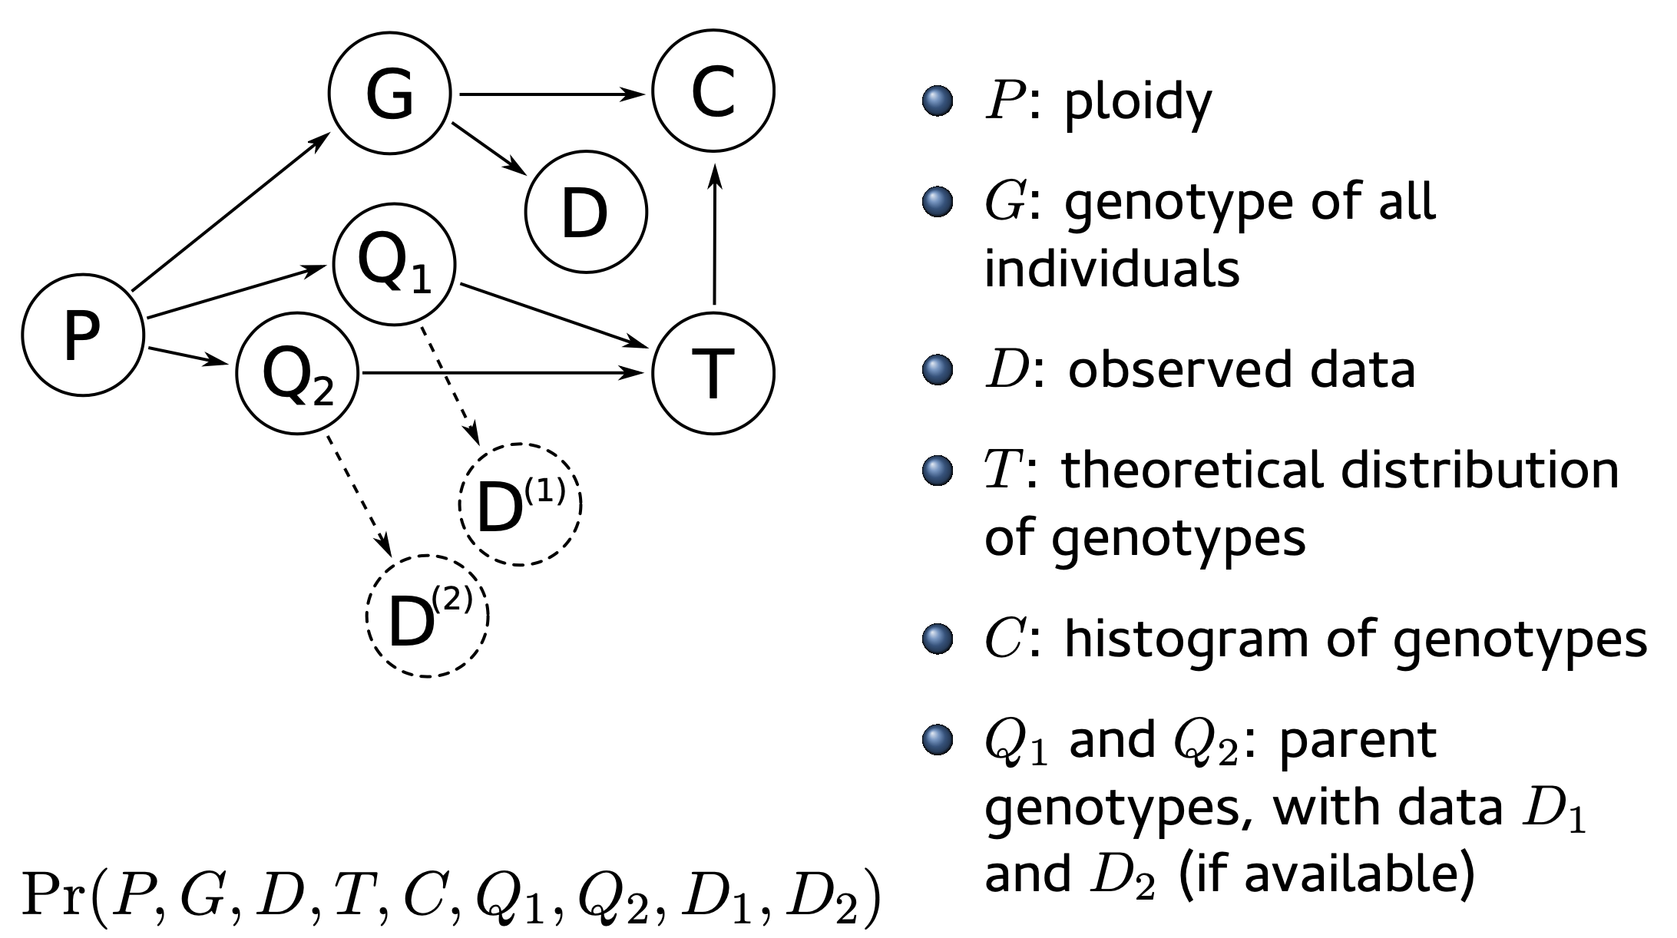
Probabilistic graphical model

Slide 5
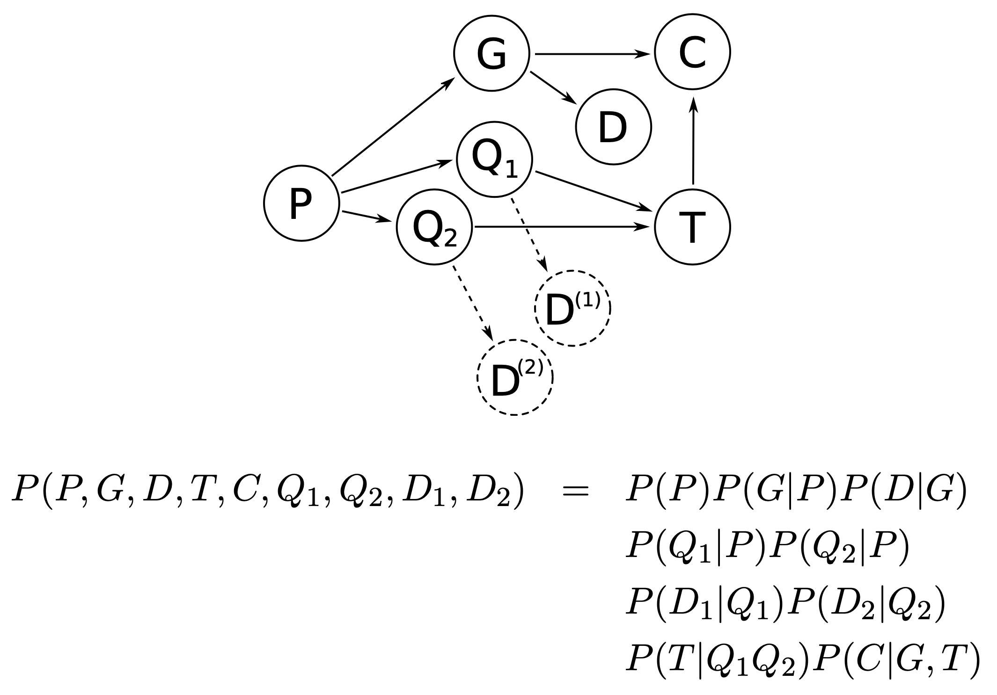
Probabilistic graphical model
Maximum a posteriori configuration: It is the configuration (set of assignments) that maximizes the joint probability of the network, given the evidences (observed data)

Slide 6
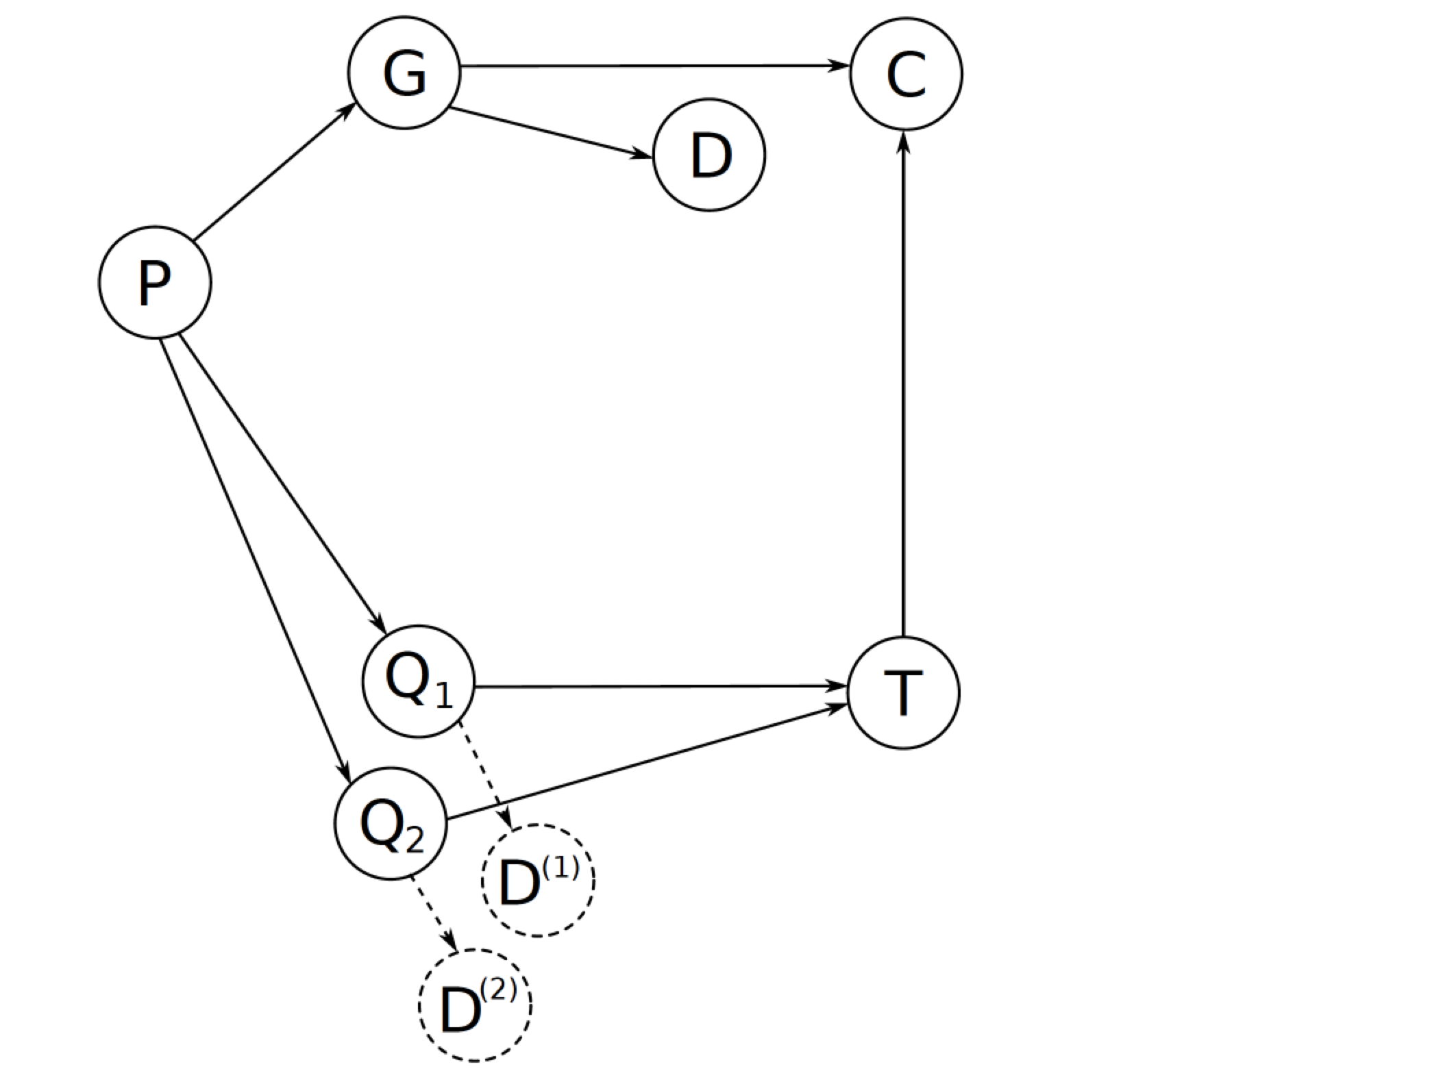
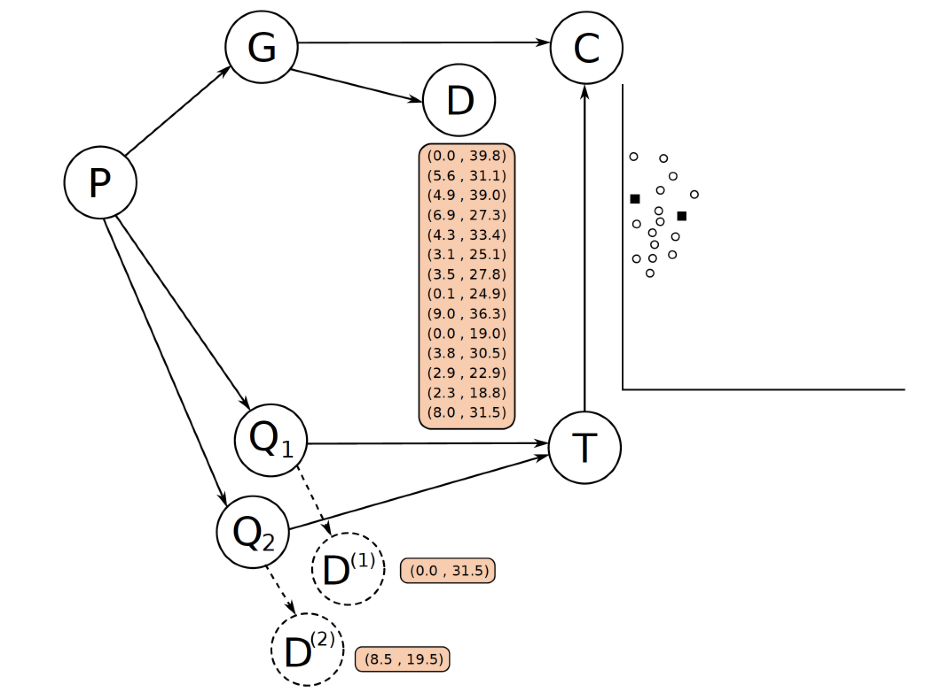
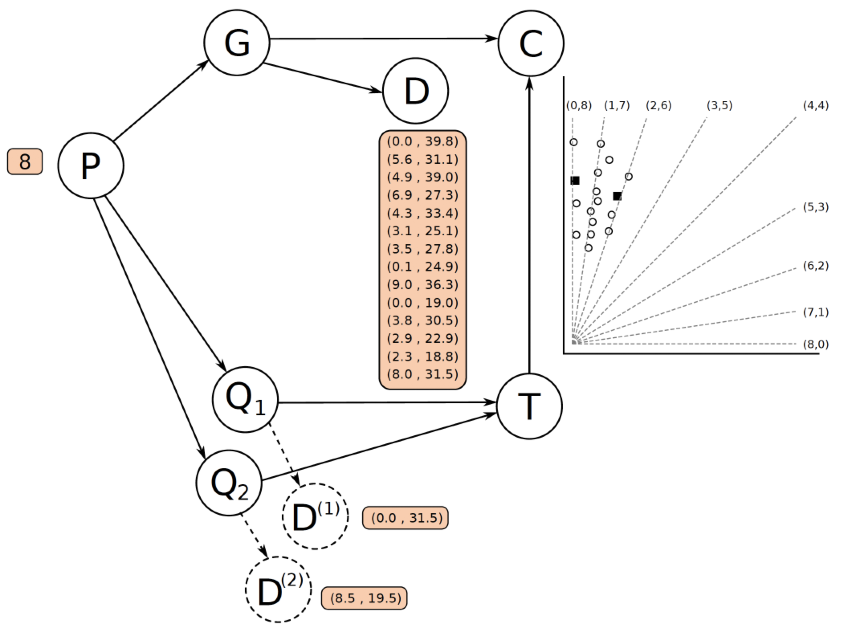
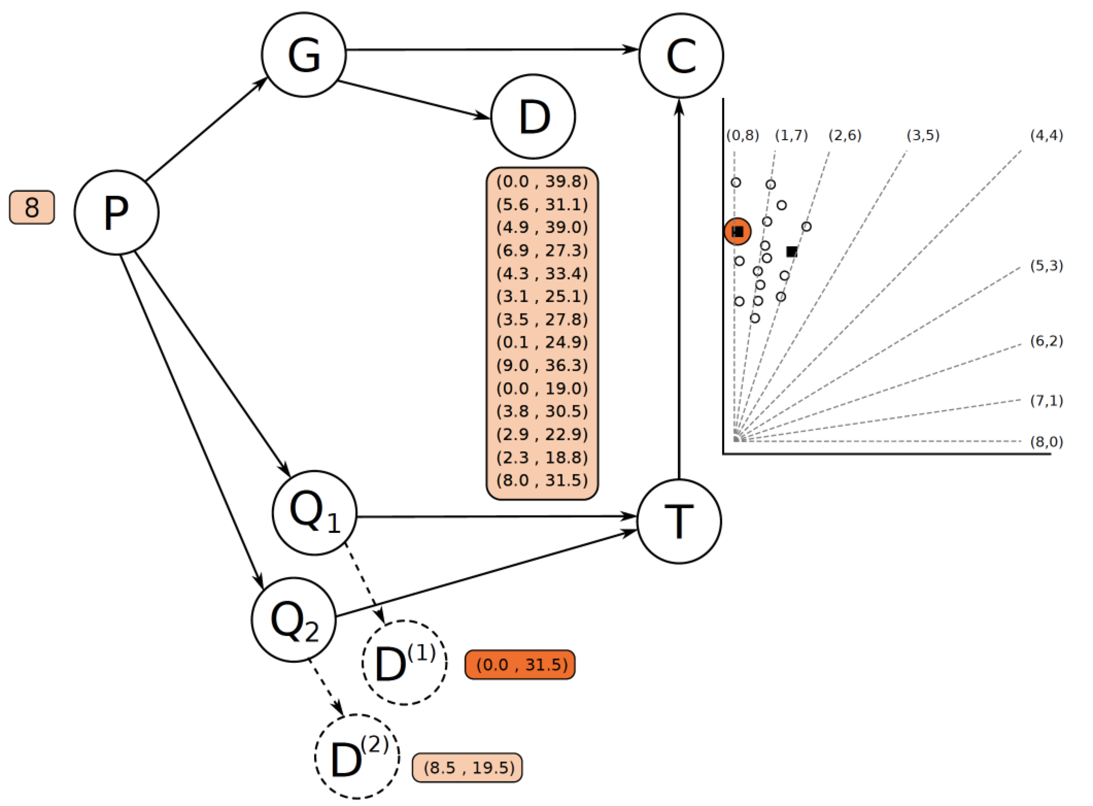
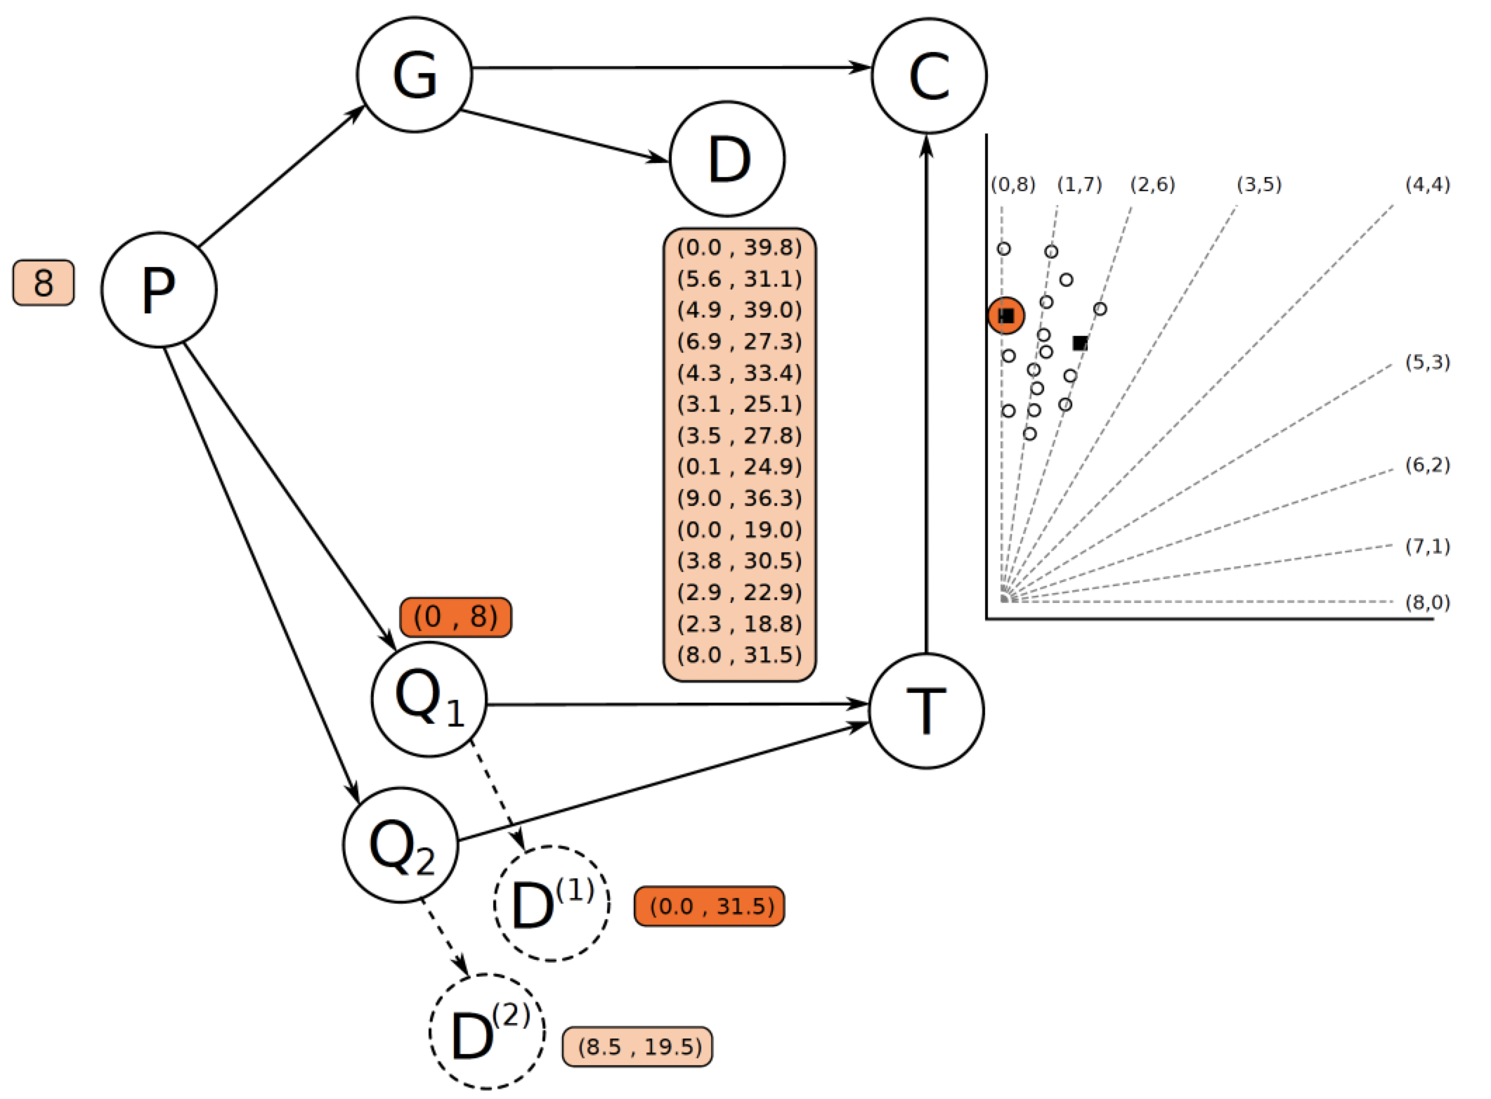
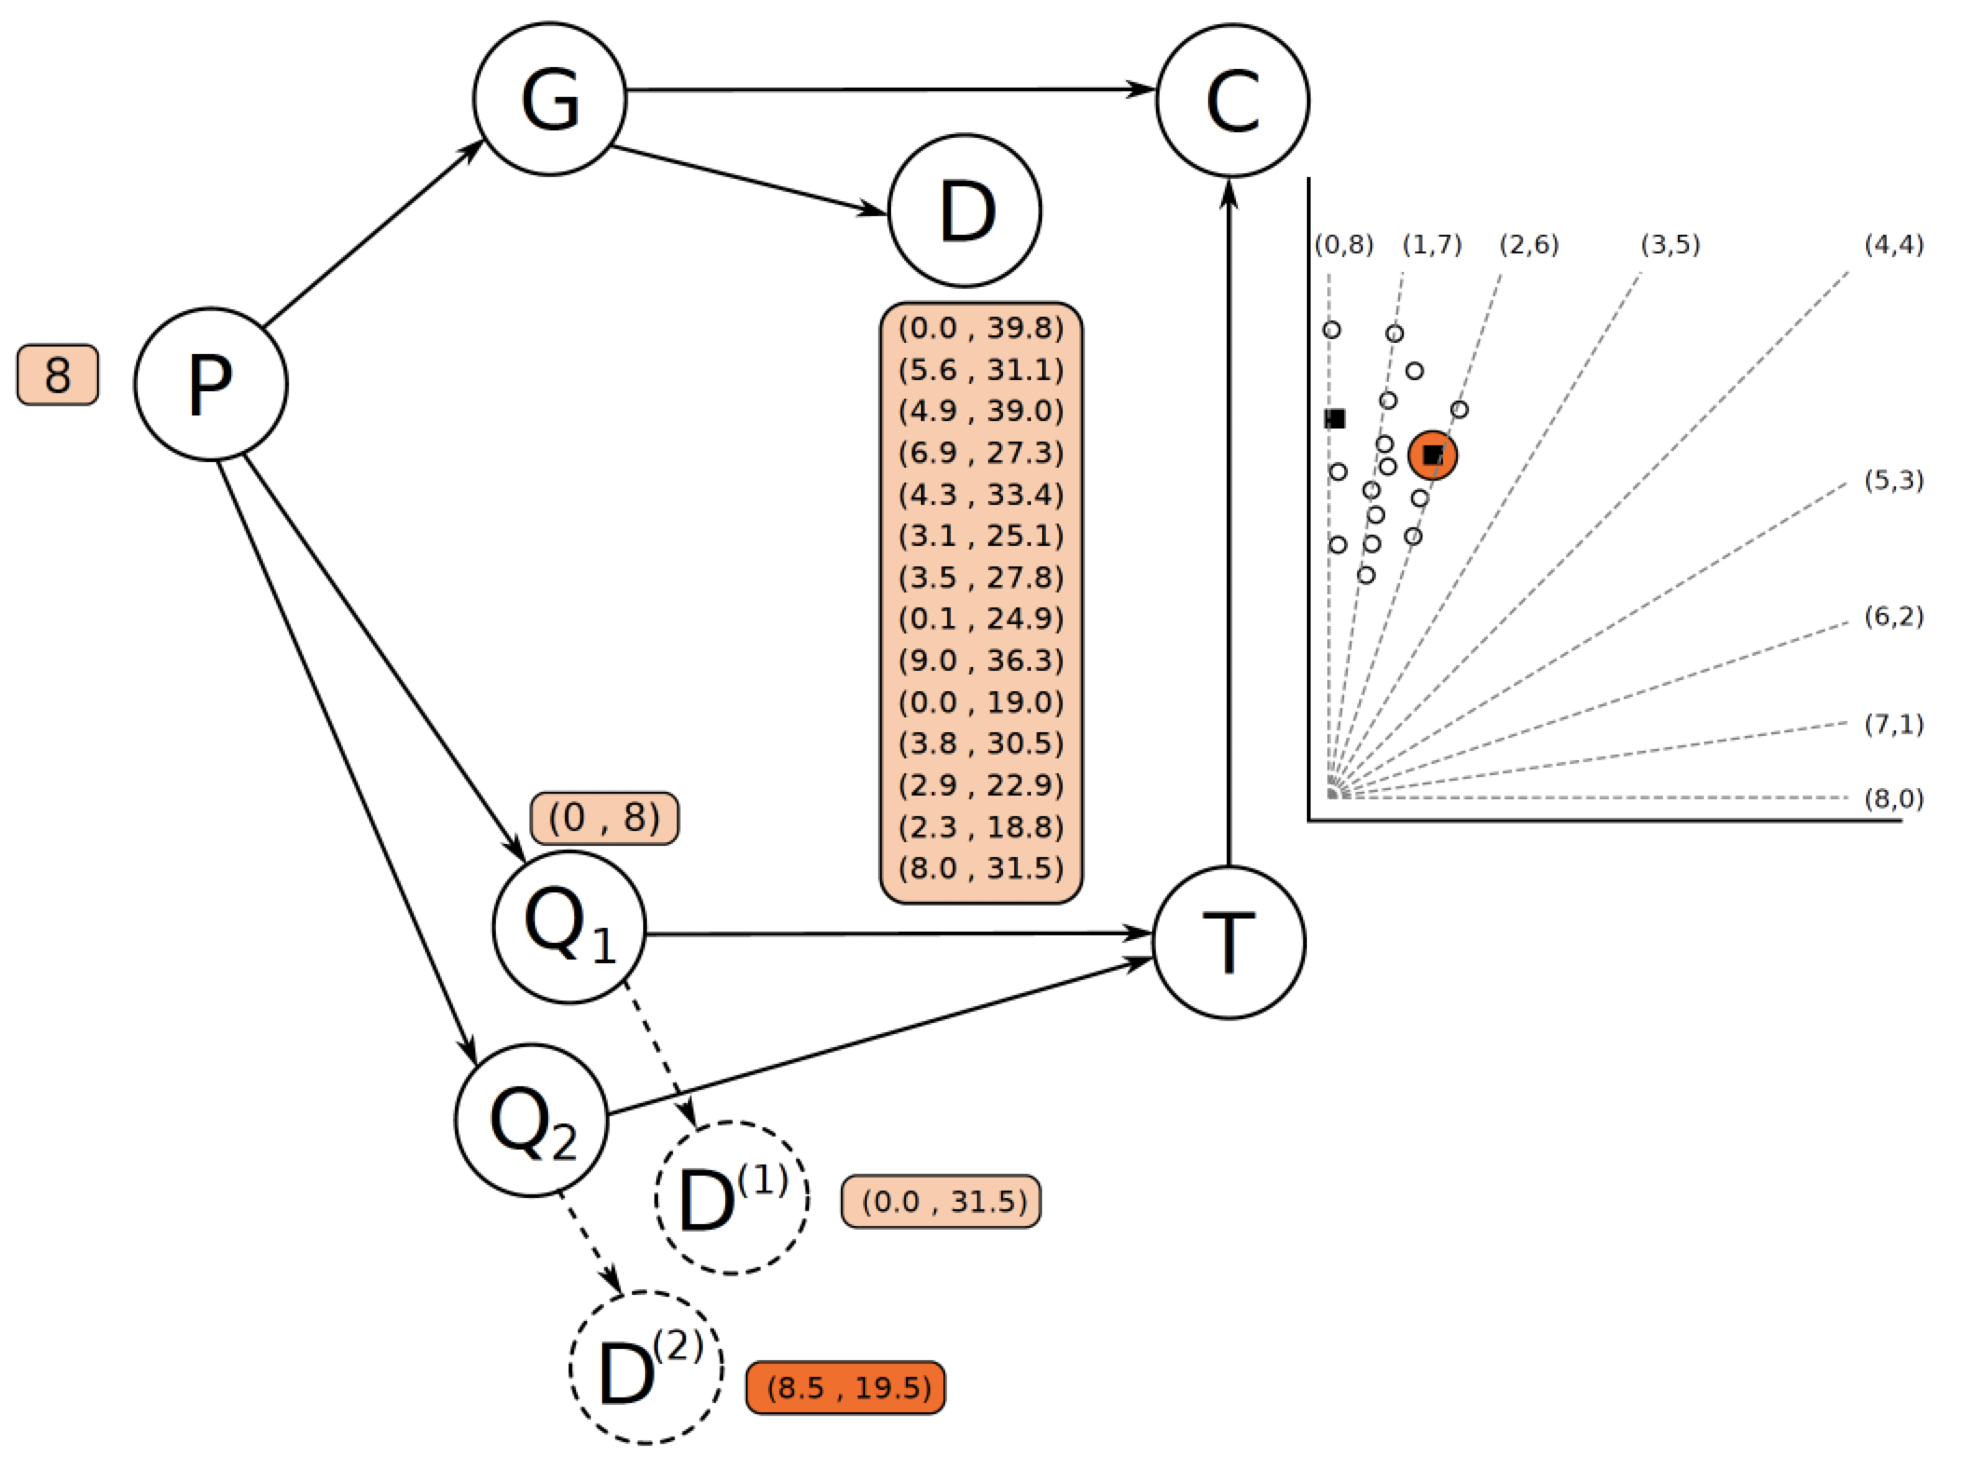
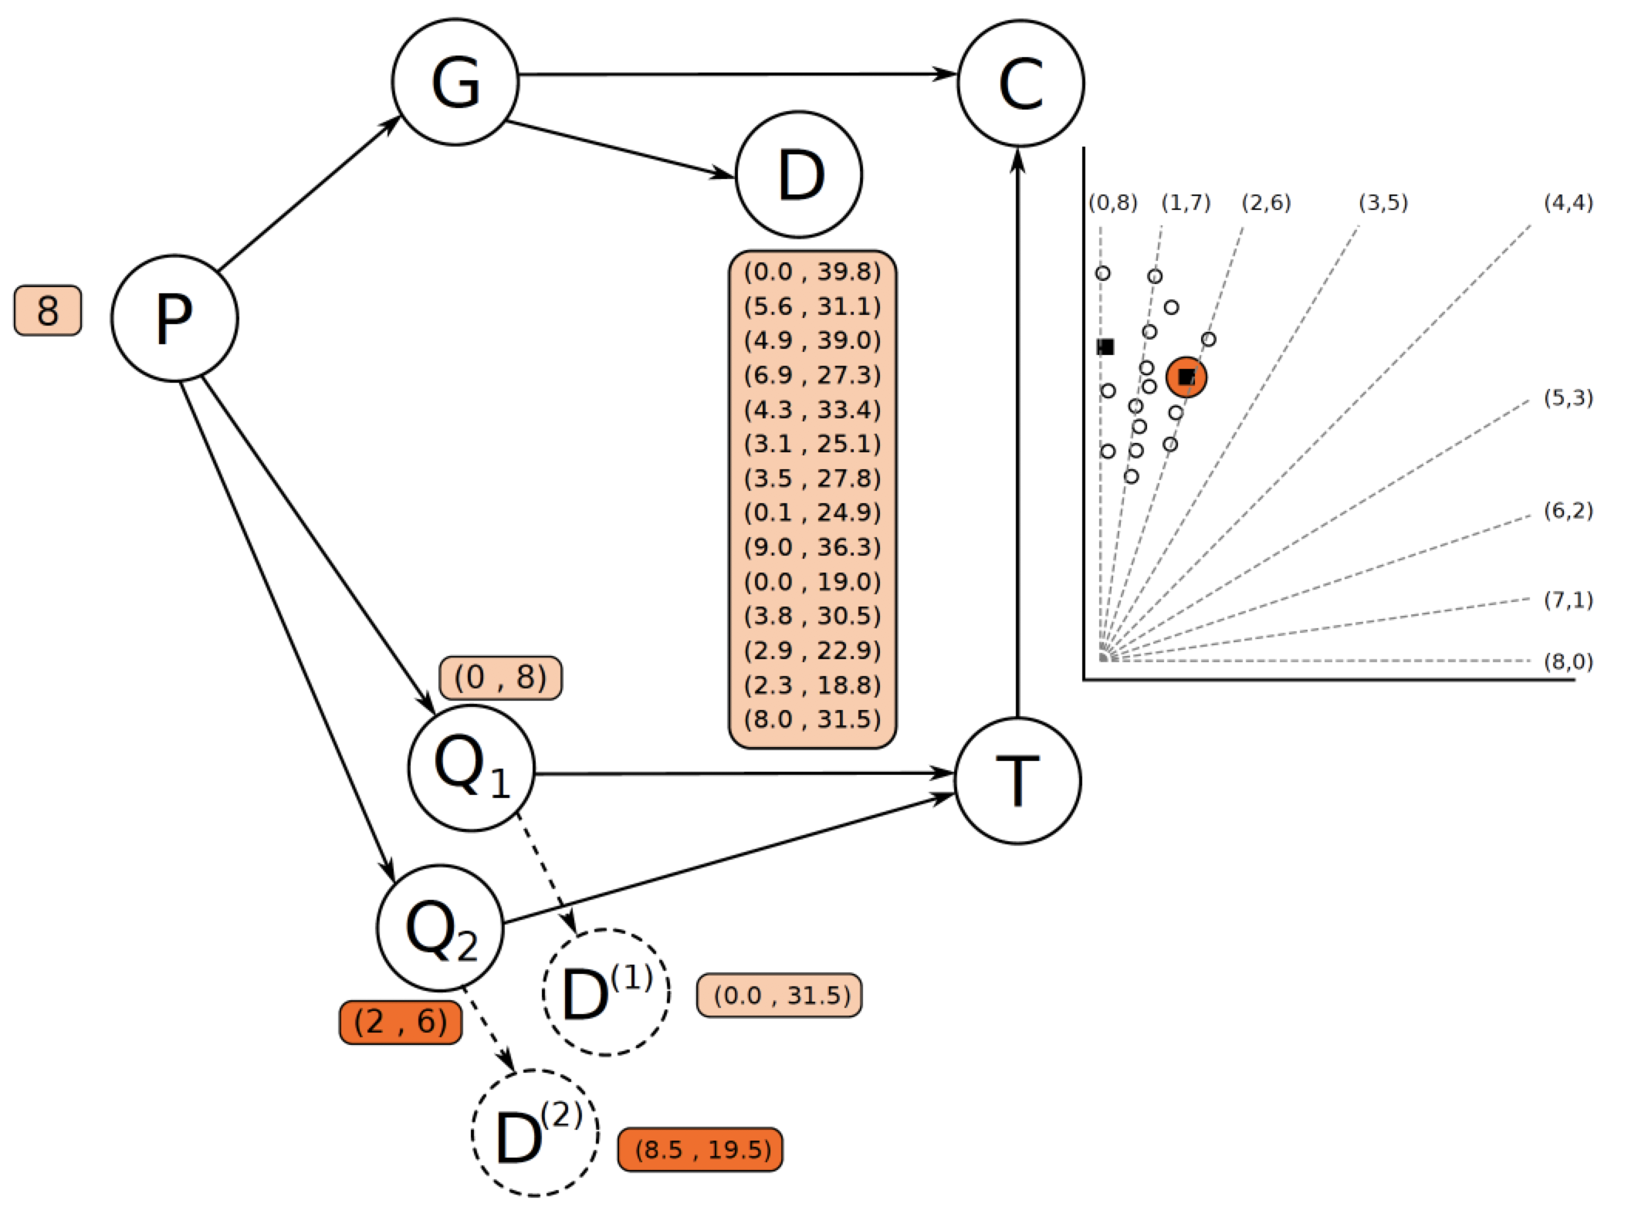
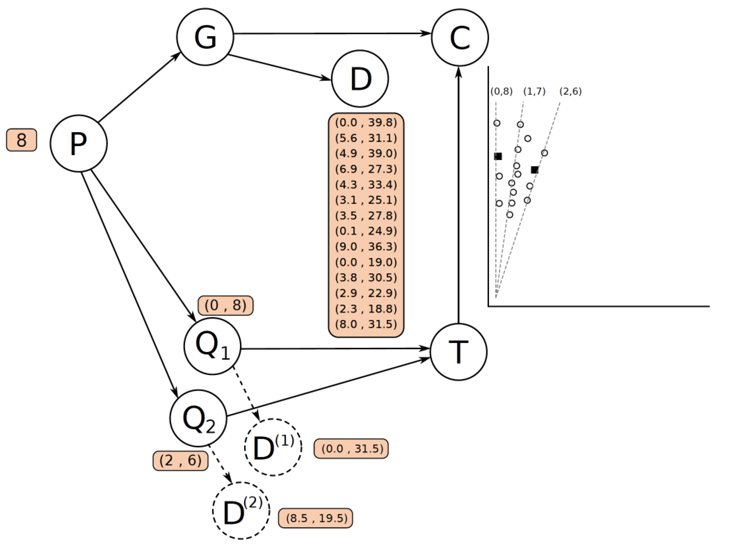
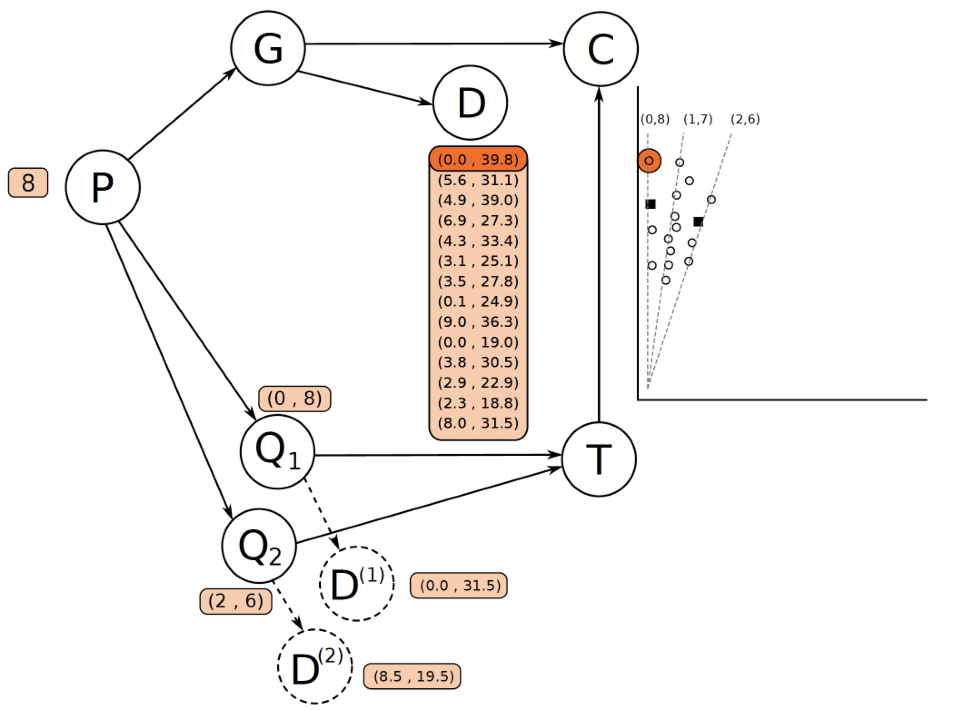
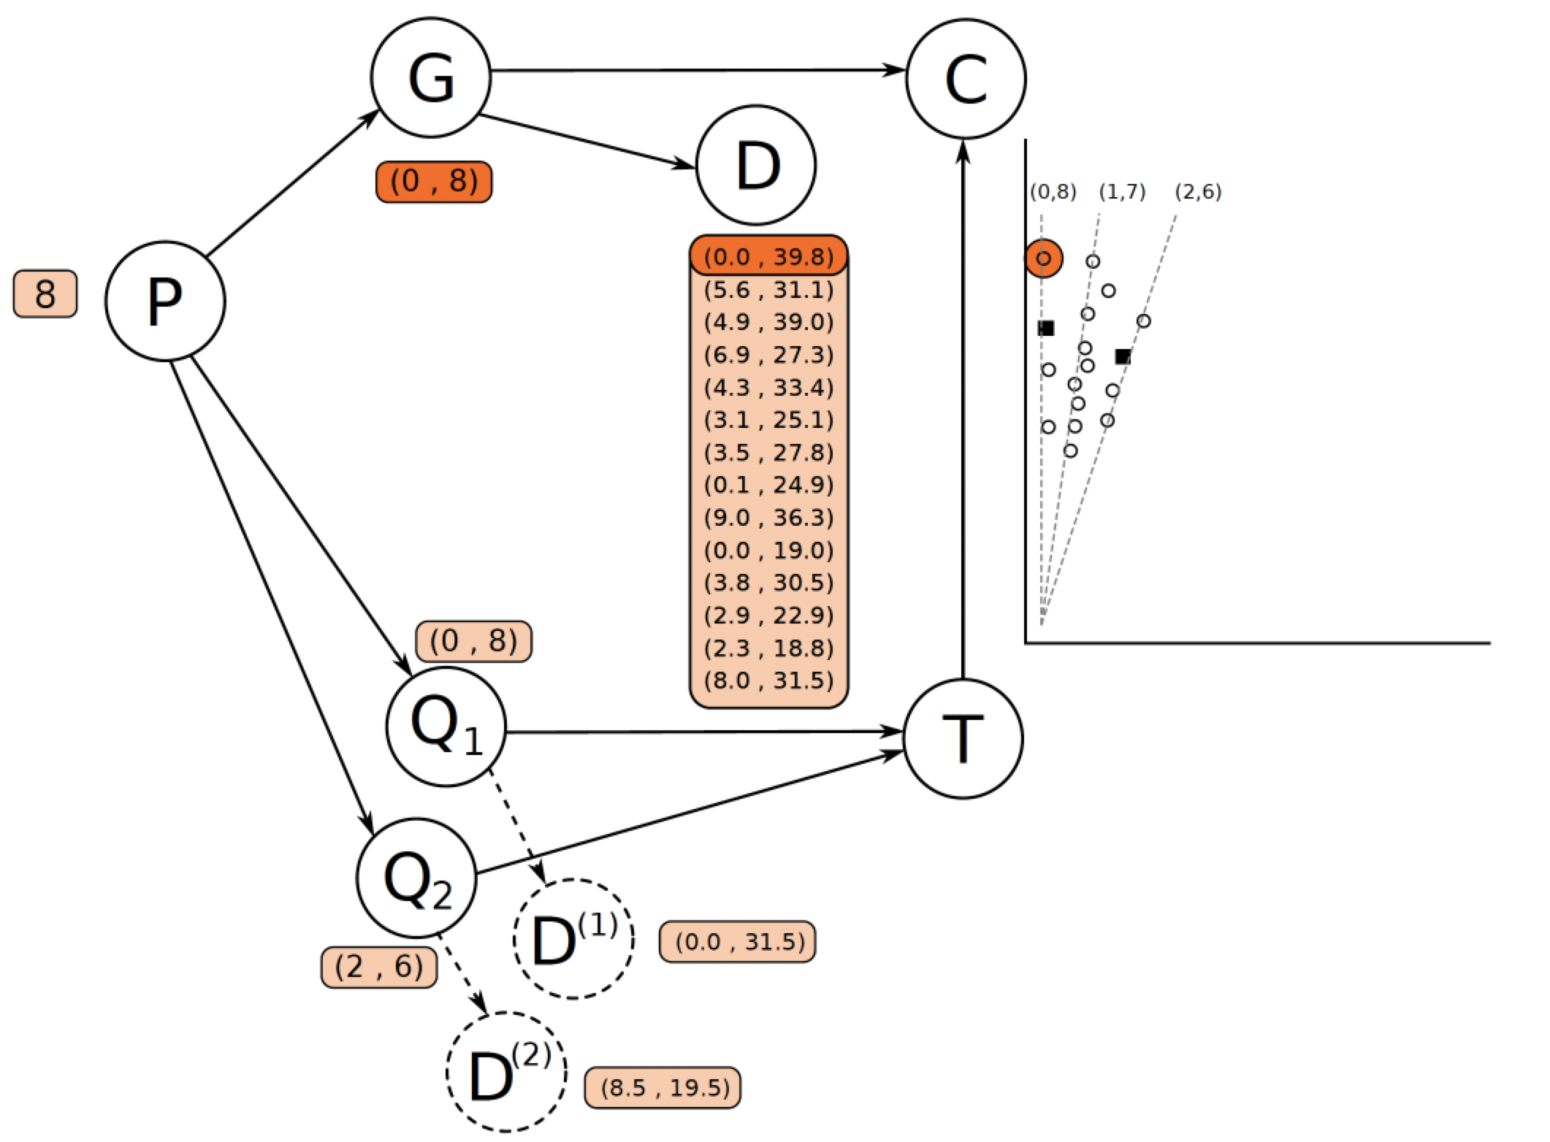
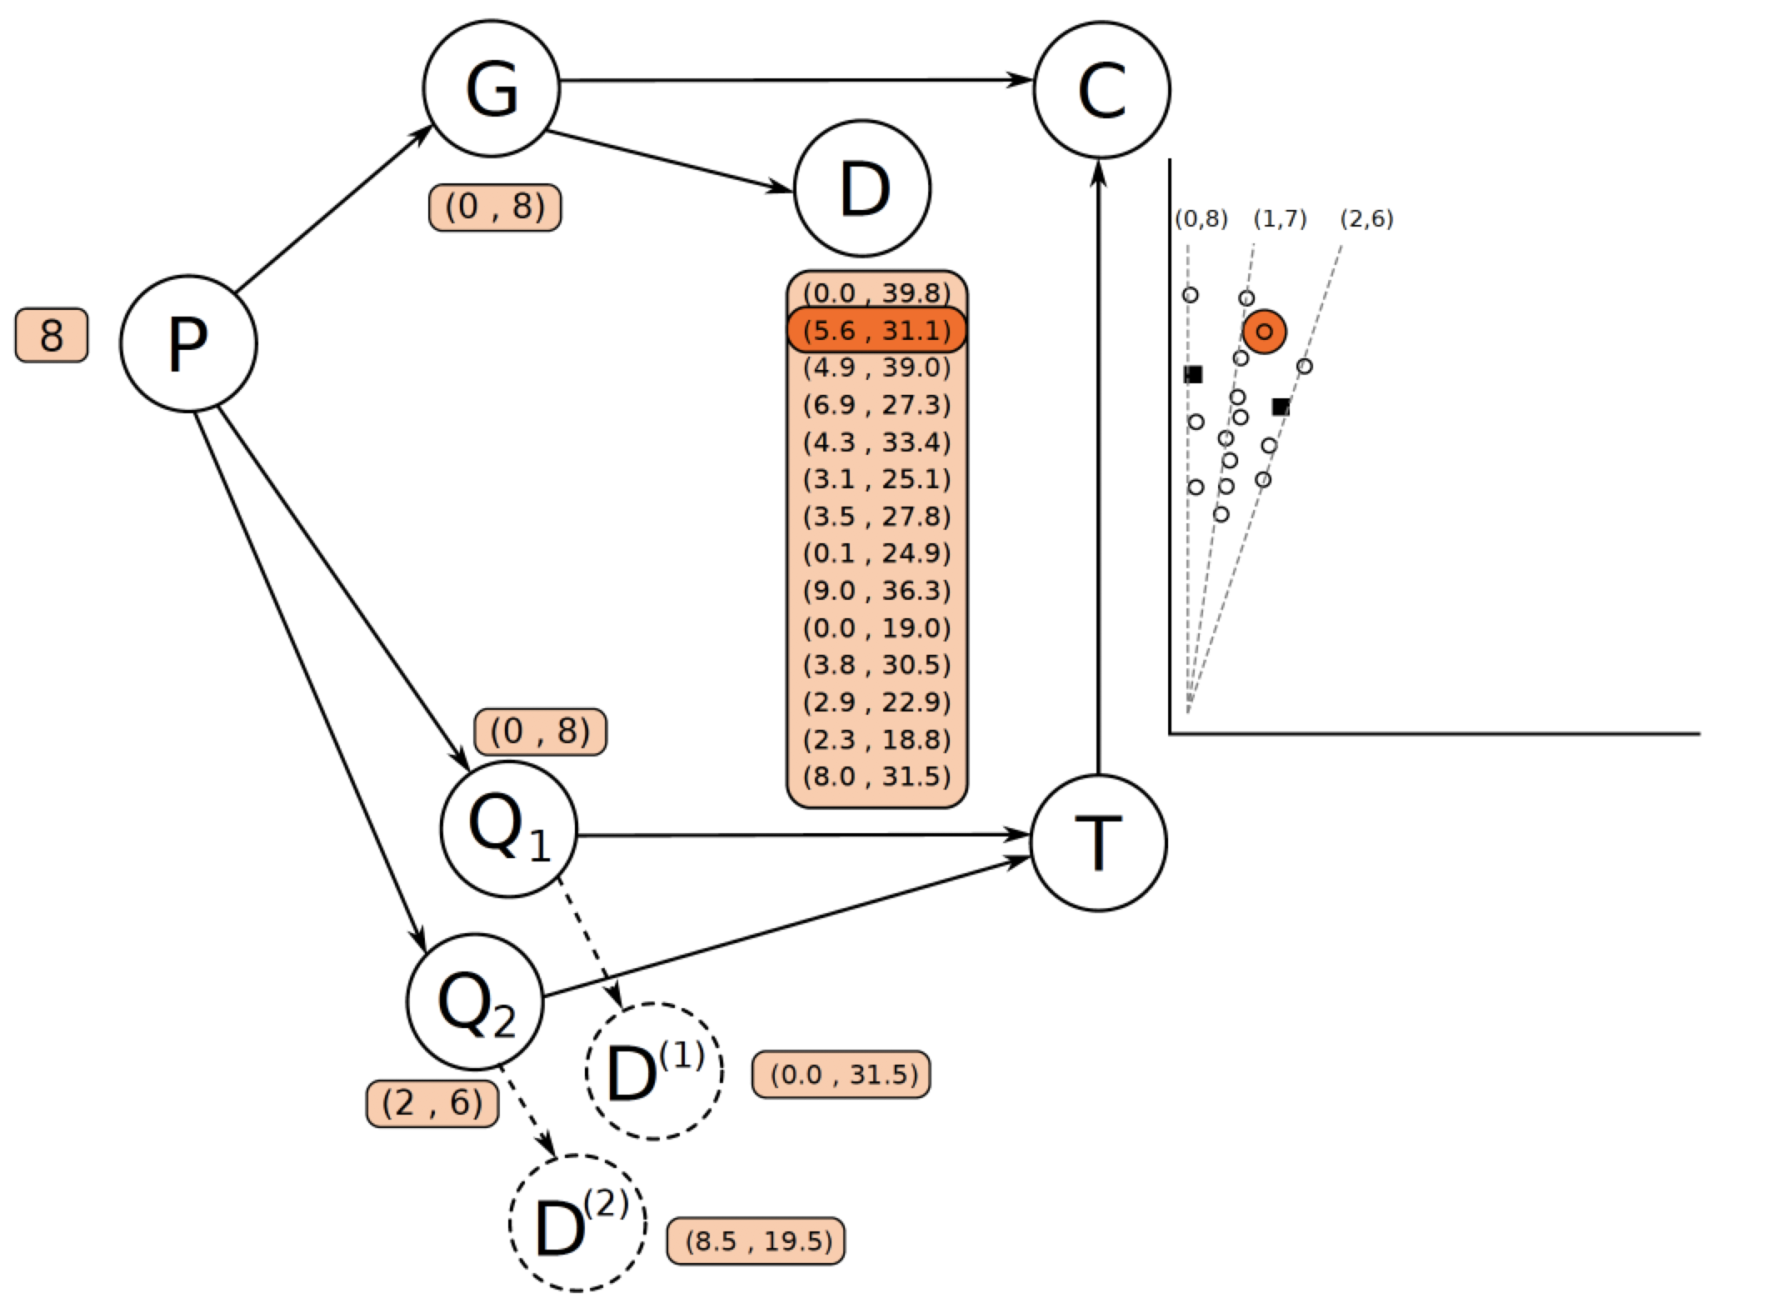
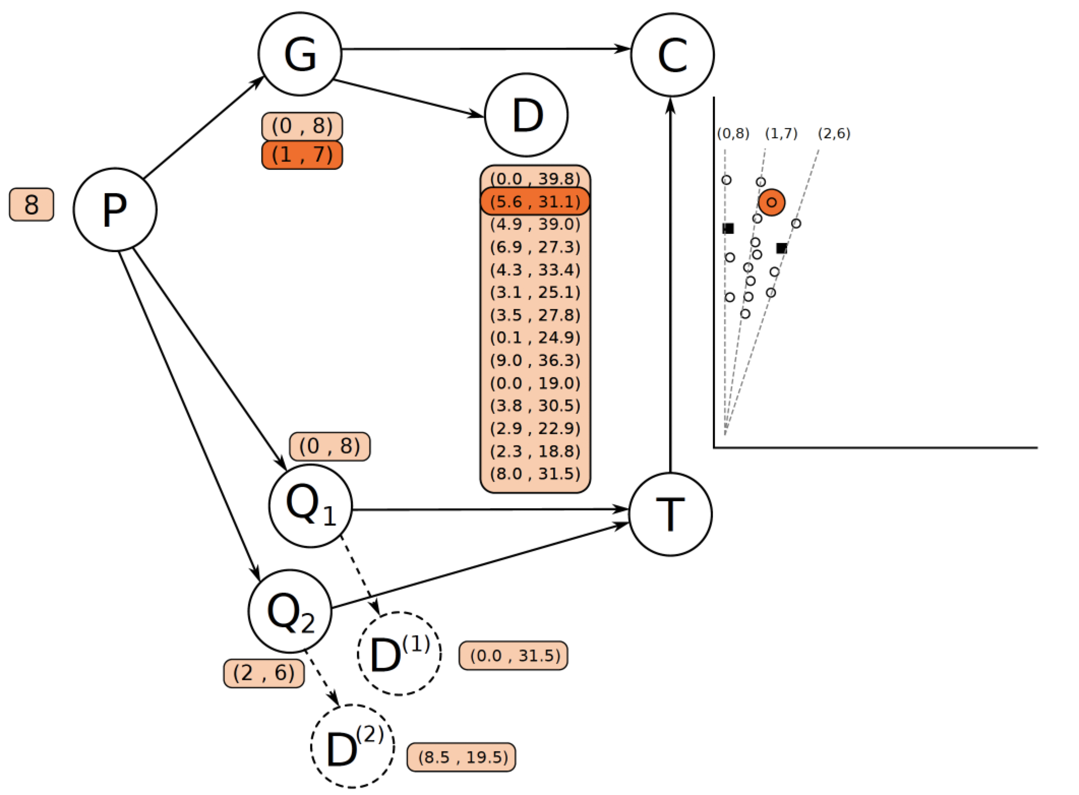
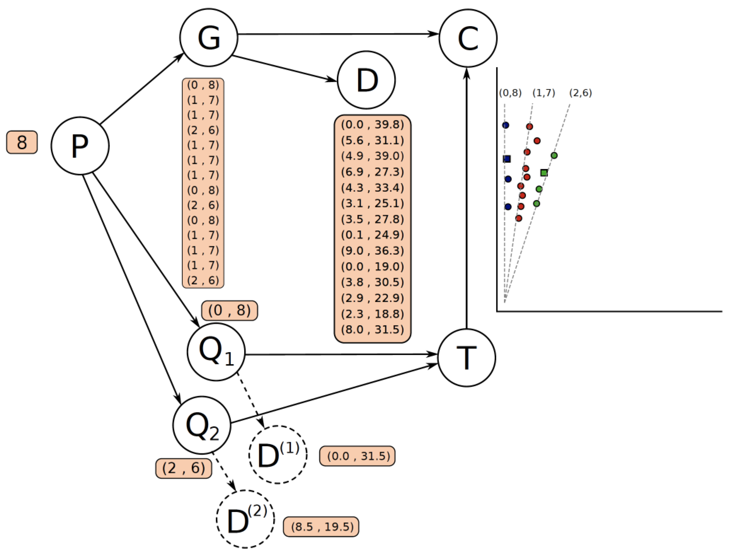
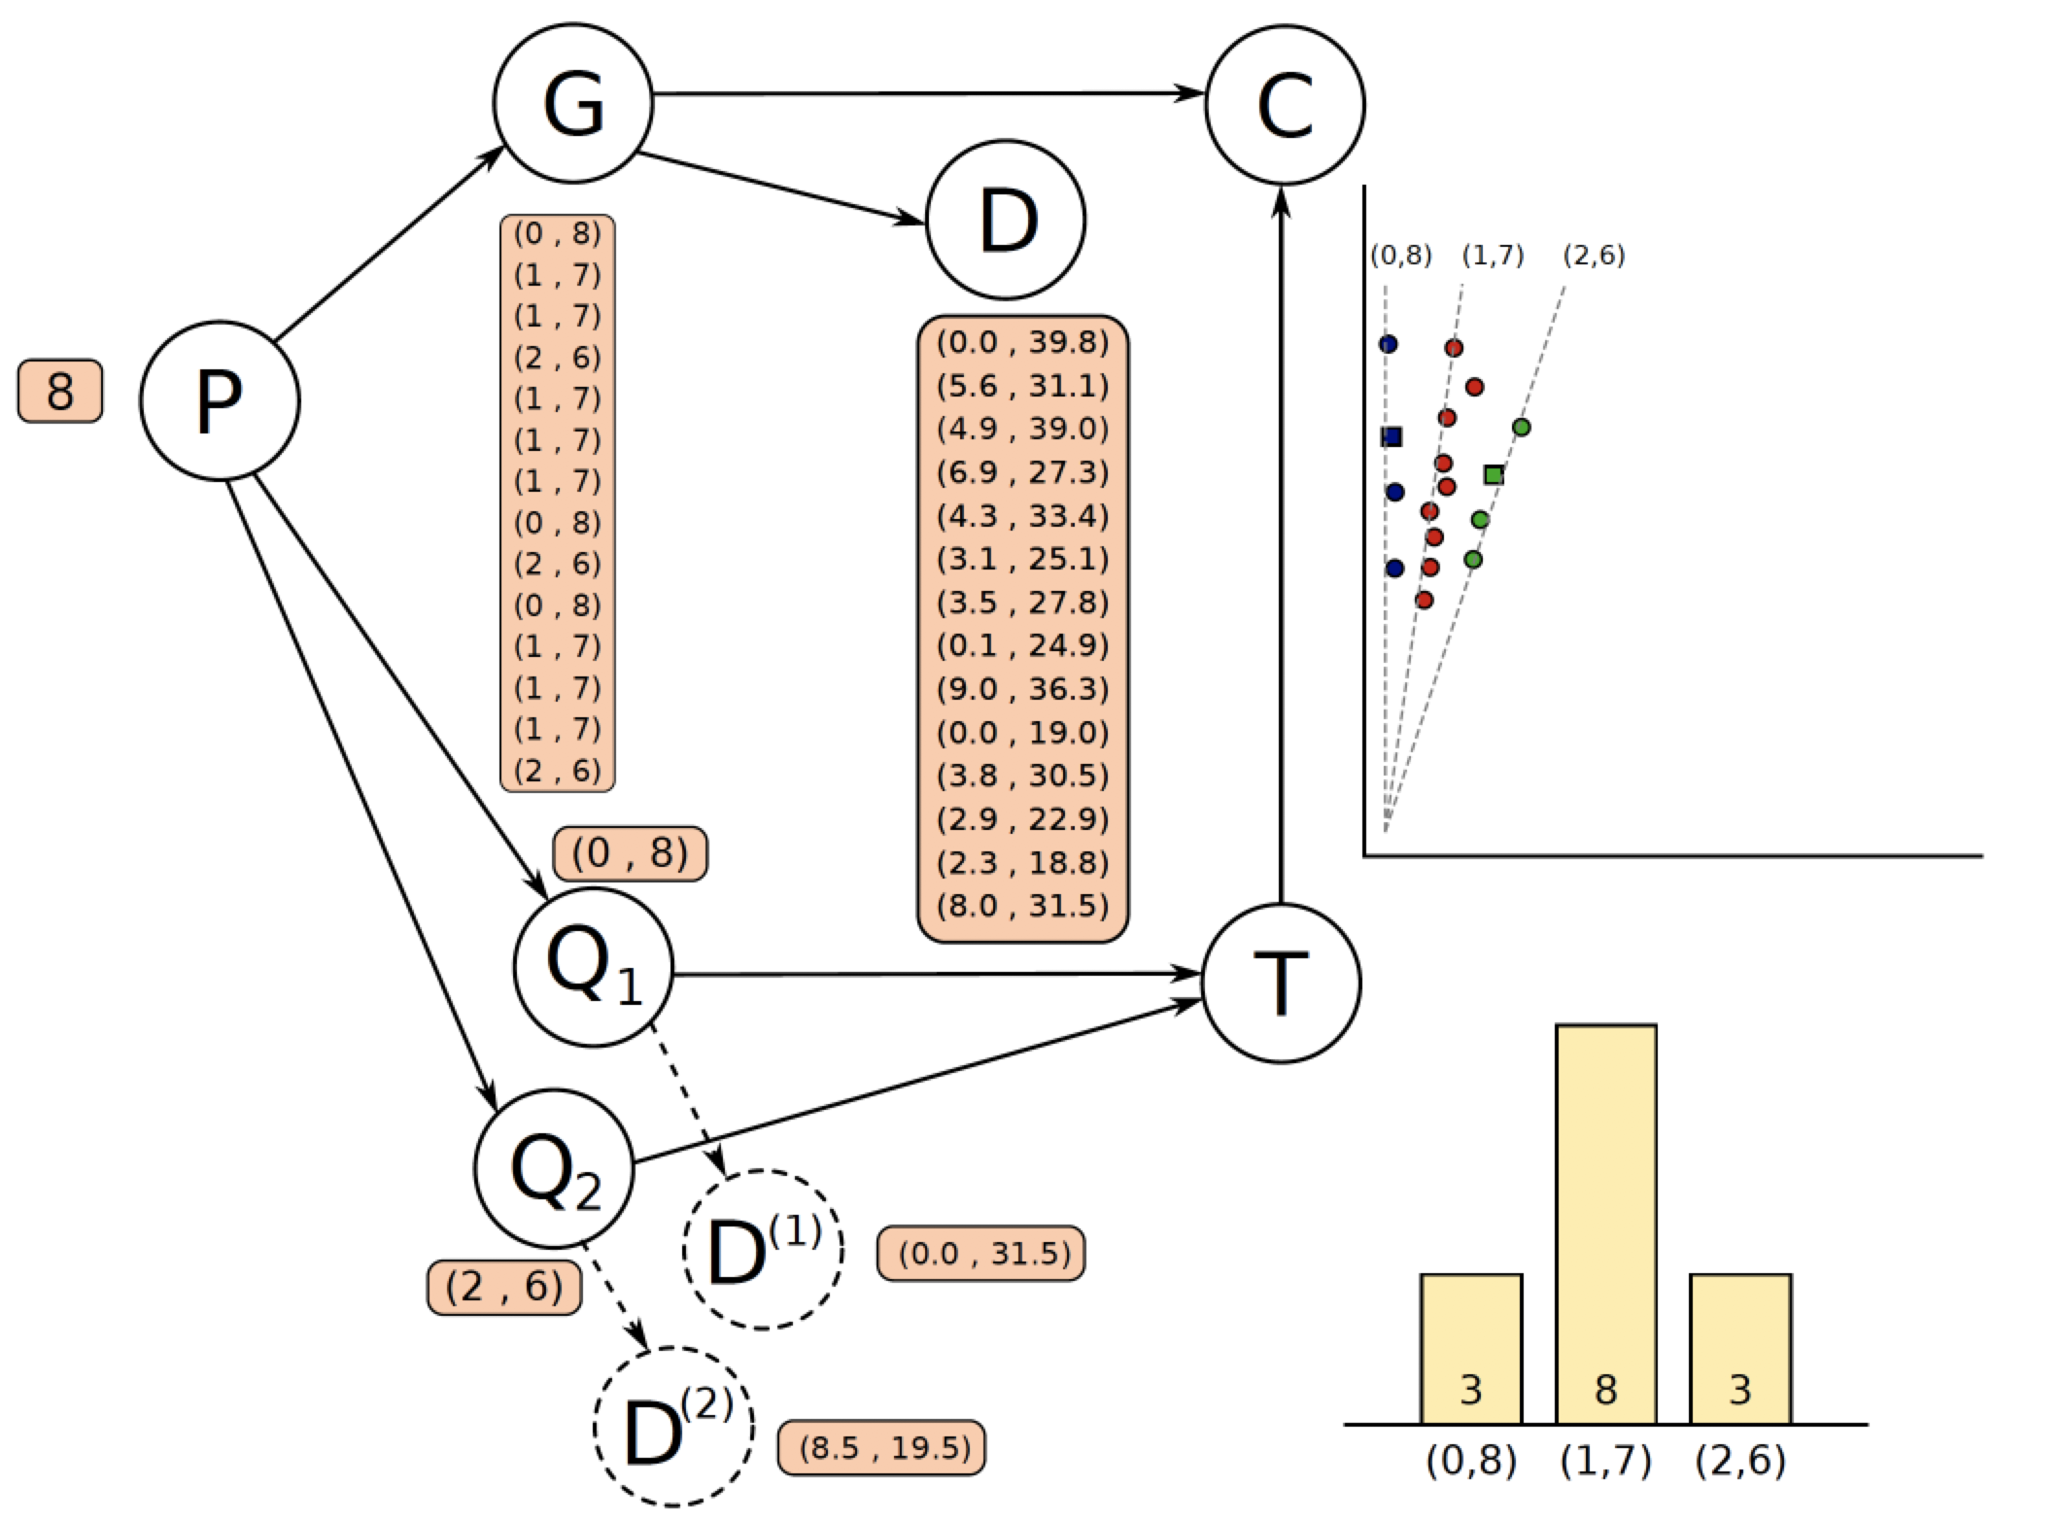
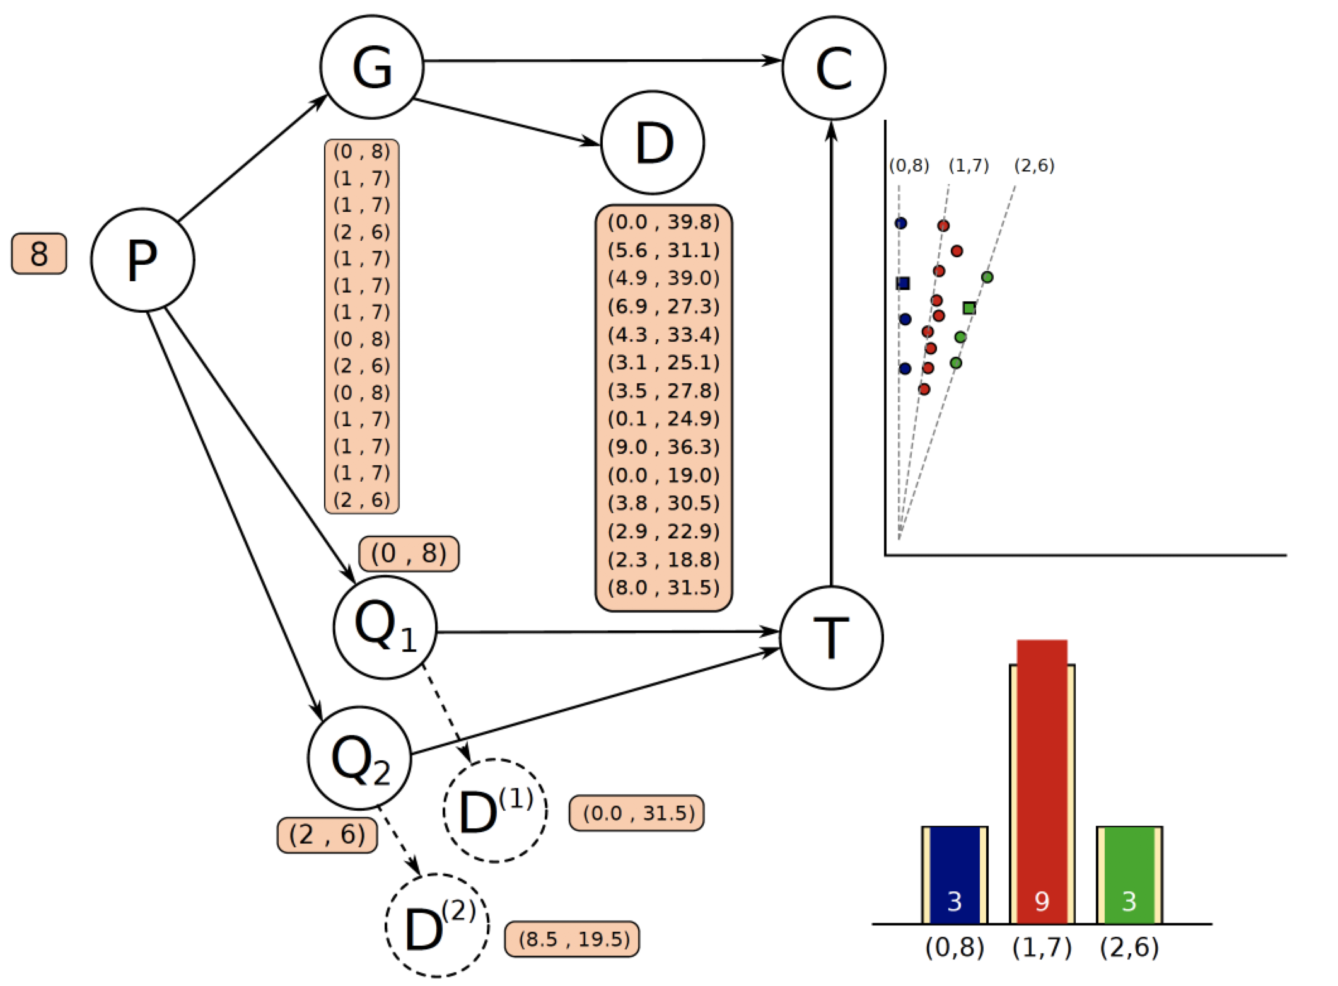
Probabilistic graphical model

Slide 7

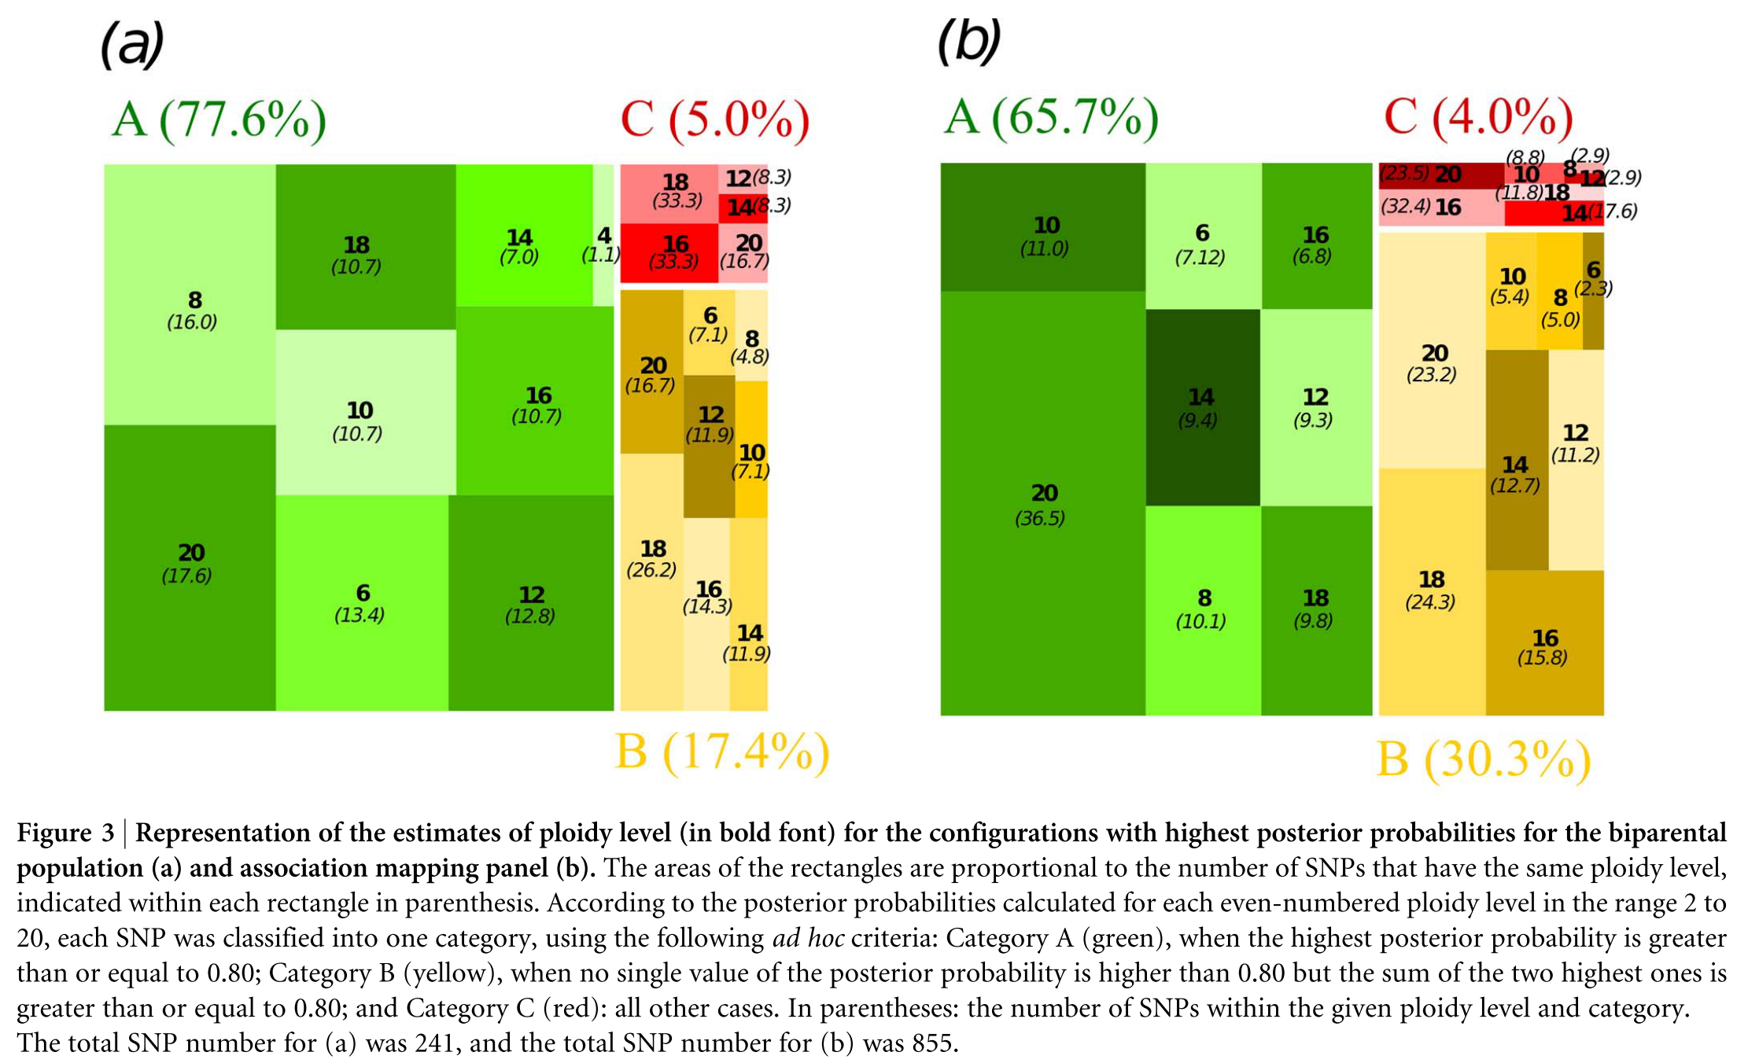
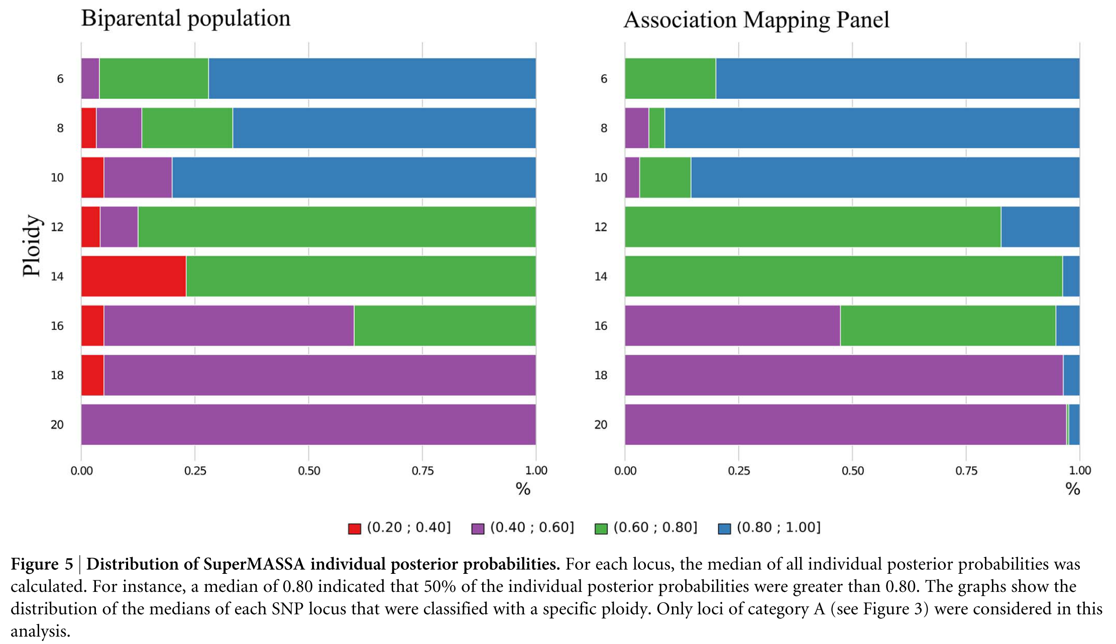
Ploidy level estimation in a sugarcane biparental population
Code: to be included

Slide 8
Genotype calling in a sweetpotato biparental population using VCF2SM
python VCF2SM.py -i ../data/sample_vcf/sample_ch+.vcf \
-o sample_trifida_sm_chr+.vcf \
--sF 1 \
--eF 3 \
-d 20 \
-D 2000 \
-a AD \
-g BT \
-1 Beauregard \
-2 Tanzania \
-S ~/repos/supermassa/src/SuperMASSA.py \
-I f1 \
-M 2:6 \
-f 6 \
-p 0.80 \
-n 0.75 \
-c 0.75 \
-t 24

Slide 9
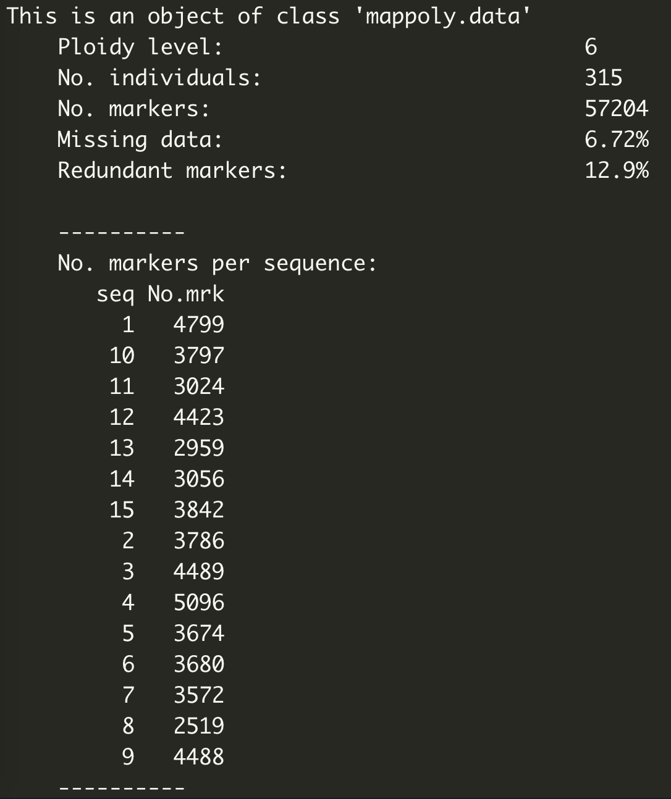
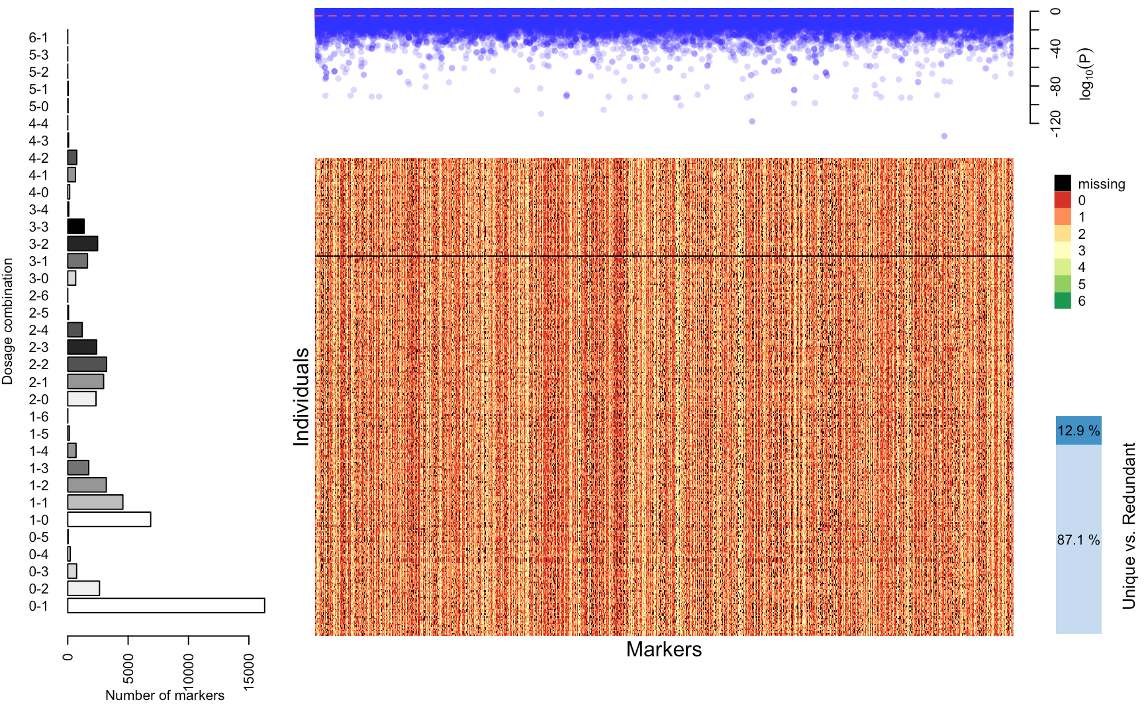
Genotype calling in a sweetpotato biparental population using VCF2SM

